Slide 1
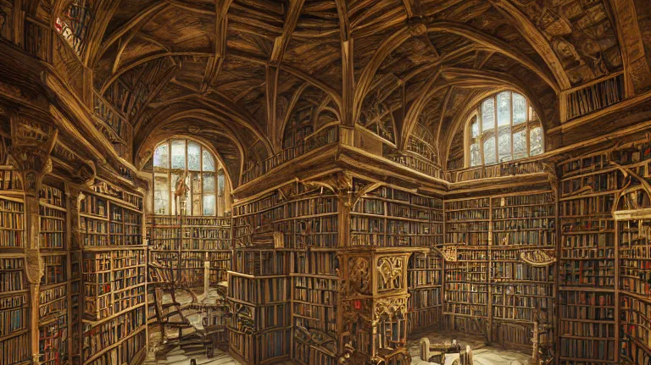
Nexus Lorekeeper Adventure Chronicler
Luis E. Rodríguez Reyes

Slide 2

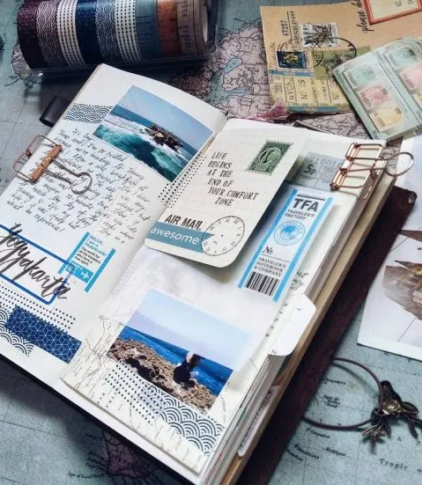
Here’s my Pitch
Stories shape us.
Keeping them in track is HARD.

Slide 3
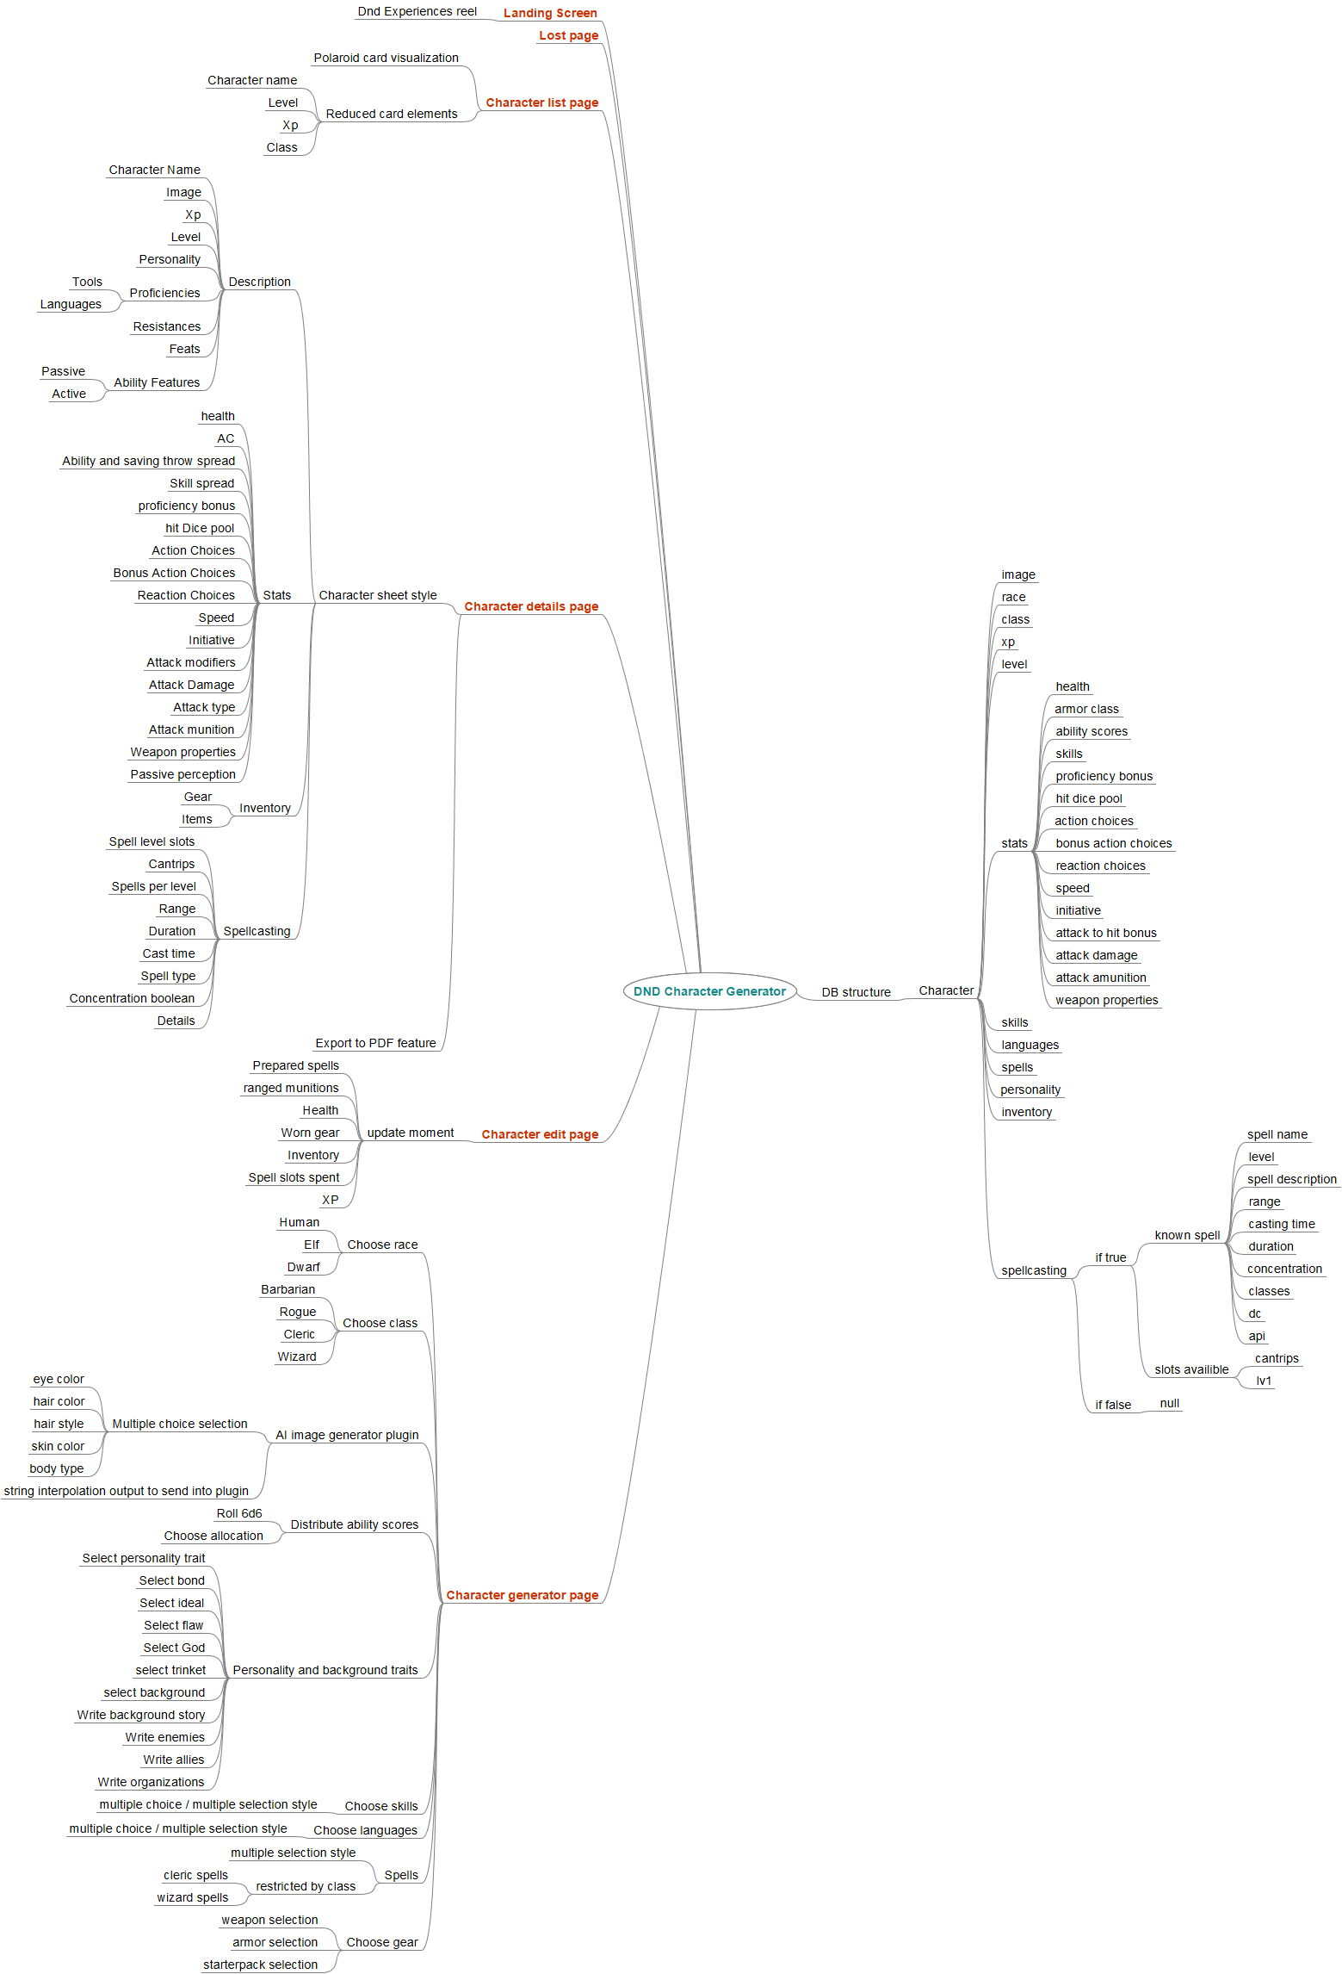
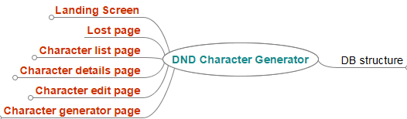

Slide 4
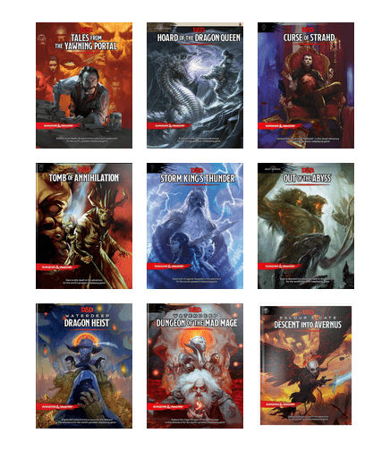
My nat 1 moment...
SCALE
DND Complexity
Yeah, its HUUUUUGGGGGEEEEEE in scope.

Slide 5
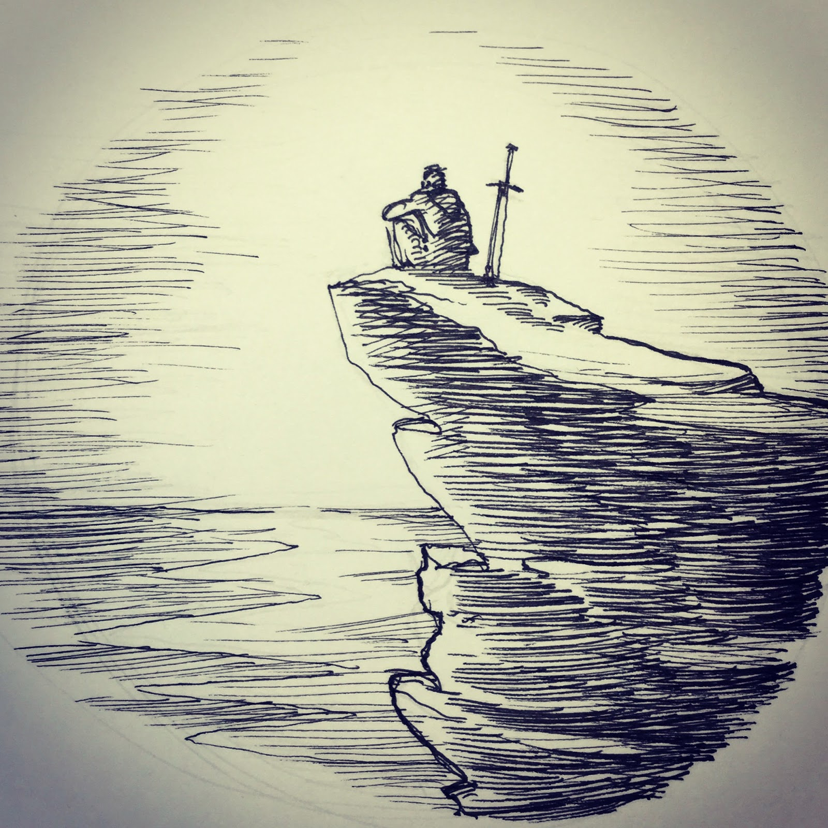
The struggle: OPEN AI
OPEN-AI account generation
Request limits
Deployment

Slide 6
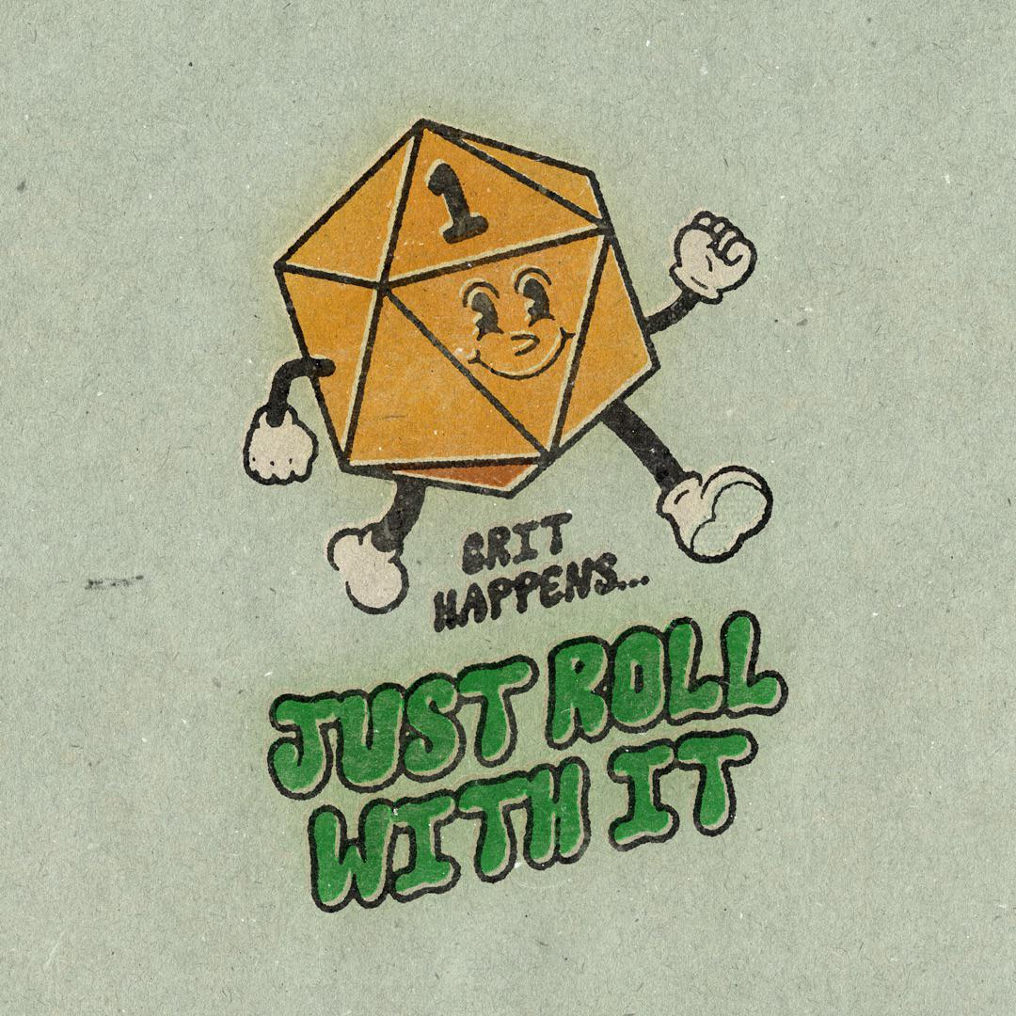
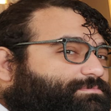

thanks guys!
https://github.com/lerodriguezreyes/mock-server-dnd-character-generator
https://github.com/lerodriguezreyes/dnd-character-generator

